Slide 1



In Here, it’s always Friday…
Group 4
Rony Chacko | Saurabh Patil | Raviteja Kondubhatla | Maitreyi Telang

Slide 2
Agenda
Executive Summary
Marketing Strategy
Customer Behavior Analysis
Revenue Contribution
Financial Implication
Customer Preferences & Recommendations
Test Plan for Recommendations

Slide 3
Executive Summary
TGI Friday’s is American restaurant chain founded in 1965 in New York. It has 1000 restaurants in 61 countries around the world.
Business Objective
Our aim is to improve revenue from the current customers by enhancing depth and breadth of their purchase portfolio.
Financial Impact
Our strategy proposes to increase revenue by +$32 million by identifying potential customer segments and; applying predictive modelling techniques like market basket analysis and elasticity modelling to analyze impact of price by segment.

Slide 4
MARKETING strategy
Objective
Maximize Revenue $$$
Highest Revenue Contributing Segments
Price Sensitivity Analysis
Food Product Bundling
Discounts
Optimize
Analyze food preferences & trends
Understand Price Sensitivity and Revenue Contribution
Segmentation to identify potential Customers
Identify improvement areas
Remove ineffective food product bundles
Apply Test & Learn Plan
Lowest Revenue Contributing Segments

Slide 5
Customer BEHAVIOR ANALYSIS
REDEEMERS
PARTYGOERS
PATRONIZERS
WEEKENDERS
THRILLSEEKERS
Value meals
High discounts
Bar
Low distinct items
Low net sales
Occasional
Breakfast/Lunch
1-2 courses
Appetizers, Buffets, Burger combo, sides
No soup/salad options
No kids
Late night
Young adults topping up before/after a event
High value
High distinct items
High total items
High sales/check
Bar/Takeout
Breakfast/Late night
Most frequent
Family meals
High distinct items, total items, net sales
Buffet, kids meals, entrees, soup/salad
No alcohol
Rest/Service
Lunch & Dinner
TGIF!
High value items – alcohol, entrees, desserts
High net amt/item
High net sales/check
Restaurant
Dinner
Least Frequent

Slide 6
CUSTOMER Revenue CONTRIBUTION
Customer SEGMENTATION
The segment Weekenders contribute to maximum revenue (approx. 23%)
Redeemers are the highest customer chunk (27.81%) but contribute to lowest revenue share (17%)

Slide 7
FINANCIAL IMPLICATIONS
The total percentage increase in sales after price sensitivity analysis is 8%.
INSIGHT:
Today’s TGIF’s revenue is $404.438 millions which can be increased by +32 millions.
 | REDEEMERS | PARTYGOERS | PATRONIZERS | WEEKENDERS | THRILLSEEKERS
Current net sales​ | $412,078.65 | $270,574.60 | $349,302.57 | $488,055.04 | $398,773.60
Change to transaction amount | 10% | 10% | 10% | - | 10%
New net sales | $424,441.52 | $276,966.01 | $356,949.57 | - | $401,039.83
Percentage Increase | 3% | 2% | 2% | - | 1%
Source: http://www.hoovers.com/company-information/cs/revenue-financial.tgi_fridays_inc.827b6119c863e4df.html

Slide 8
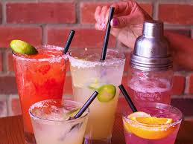
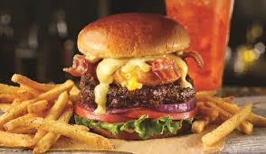
CUSTOMER PREFERENCES & RECOMMENDATIONS
REDEEMERS
Preference: Burgers and Combo.
Recommendation:
Bundle beverages with burgers and Appetizers with Alcohol.
PARTYGOERS
Preference: Appetizers, Brunch, Buffet, Burgers and Combo.
Recommendation:
Bundle desserts with burgers. Promote Appetizers with Soup-Salad & kids Combo.
PATRONIZERS
Preference: Alcohol, Appetizers, Steak, Desserts and kids meals.
Recommendation:
Bundle beverages with burgers. Promote Appetizers and Steak with Alcohol.

Slide 9

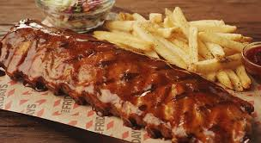
CUSTOMER PREFERENCES & RECOMMENDATIONS
WEEKENDERS
Preference: Drinks and Buffet.
Recommendation:
Bundle light entrée with buffet.
Promote Steak and Appetizers with Alcohol.
THRILLSEEKERS
Preference: Alcohol, Desserts & Beverages.
Recommendation:
Best items to bundle :- Alcohol and Appetizers.
Promote burgers in brunch menu since people are more likely to buy burgers
in brunch.

Slide 10
TEST PLAN FOR Recommendations
IMPLEMENTATION ON TEST MARKET
Take samples from each segment for test and validation.
Testing of recommendations on these samples.
Comparing revenues of test & validation groups.
TEST IMPACT
Record and analyze changes due to bundling of food products
Analyze the effect of price sensitivity
Track customer churn rate
TEST PERIOD
Implement recommendations on test data over 6 months
Analyze monthly revenues

Slide 11
Thank God It’s Friday

